Slide 1

SWE6130 –Mobile Applications Development
Programming the Android Platform -
Introduction (Notes# 1a)

Slide 2
Basic Info
Summer Semester 2016
SWE 6130: Mobile Applications development
Instructor: Gerald Chege, PhD;
Assistant Professor of Information Systems & Technology
email: gchege@usiu.ac.ke;
Location: ICT Building– 3rd Flr. Rm. 4
Class Times: Thursdays 5.40pm - 9.00 pm
Venue: Lab#2
Office Hours: Tuesday/Thursday 10.00am - 1.00pm & 3.00pm – 5.30pm

Slide 3
Goals
Learn about
Mobile devices
Mobile device programming
The Android platform
Develop interesting Android applications
Expect lots of programming
Each student will do multiple projects

Slide 4
Class Organization
Mix of lecture and programming exercises
1 ½ hours of Theory
1 ½ hours Laboratory exercise

Slide 5
The Android Platform
A software stack for mobile devices:
Operating system, middleware & key applications
Use Android SDK to create applications
Libraries & development tools
Lots of documentation
http://developer.android.com/
Start browsing today!

Slide 6
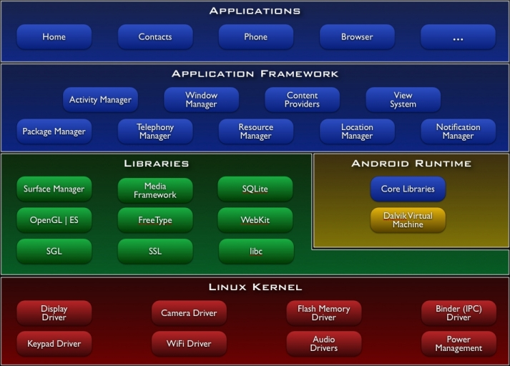
The Android Architecture
http://developer.android.com/guide/basics/what-is-android.html

Slide 7
Linux Kernel
Abstraction layer between HW & SW
Provides services such as:
Security
Memory & process management
Network stack
Device driver model

Slide 8
Linux Kernel (cont.)
Android-specific components
Binder – IPC
Android shared memory
Power management
Alarm driver
Low memory killer
Kernel debugger & Logger

Slide 9
Native Libraries
C/C++ libraries
System C library
bionic libc
Surface Manager
display management
Media Framework
audio/video
Webkit
web browser engine
OpenGL ES, SGL
graphics engines
SQLite
relational database engine
SSL
secure sockets layer

Slide 10
Android Runtime
Support services for executing applications
Core Libraries
Dalvik Virtual Machine

Slide 11
Core Libraries
Core Java classes
android.*
java.*, javax.*
junit.*
org.apache.*, org.json.*, org.xml.*
Doesn’t include all standard Java SDK classes
developer.android.com/reference/packages.html
www.zdnet.com/blog/burnette/java-vs-android-apis/504

Slide 12
Dalvik Virtual Machine
Applications typically written in Java, but do not run in a standard Java virtual machine
dx program transforms java classes into .dex-formatted bytecodes
Bytecodes executed in Dalvik Virtual Machine
Applications typically run in their own processes, inside their own instance of the the Dalvik VM

Slide 13
Dalvik Virtual Machine (cont.)
Dalvik VM designed to run on a handset
Slow CPU
Little RAM
64Mb total, ~10Mb available at runtime
No swap space
Limited battery life

Slide 14
Dalvik Virtual Machine (cont.)
Some design choices
One .dex file for multiple classes
Modified garbage collection to improve memory sharing
Optimizations applied at installation time
register-based, rather than stack-based

Slide 15
Dalvik Virtual Machine (cont.)
Memory
.dex file has common constant pool for multiple classes
Modified garbage collection to improve memory sharing
CPU
Optimizations at installation time
register-based, rather than stack-based

Slide 16
Using Registers
Expected benefits over stack-based VMs
Avoids slow instruction dispatch
Avoids unnecessary memory accesses
More efficient instruction stream

Slide 17
Dalvik Virtual Machine (cont.)
public static long sumArray(int[] arr) { long sum = 0; for (int i : arr) {
sum += i;
} return sum;
}

Slide 18
Java Bytecode
0: lconst_0 1: lstore_1 2: aload_0 3: astore_3 4: aload_3 5: arraylength 6: istore 4 8: iconst_0 9: istore 5 11: iload 5 13: iload 4 15: if_icmpge 36 18: aload_3 19: iload 5 21: iaload 22: istore 6 24: lload_1 25: iload 6 27: i2l 28: ladd 29: lstore_1 30: iinc 5, 1 33: goto 11
36: lload_1 37: lreturn

Slide 19
Dex Bytecode
0000: const-wide/16 v0, #long 0 // #0000
0002: array-length v2, v8
0003: const/4 v3, #int 0 // #0
0004: move v7, v3
0005: move-wide v3, v0
0006: move v0, v7
0007: if-ge v0, v2, 0010 // +0009
0009: aget v1, v8, v0
000b: int-to-long v5, v1
000c: add-long/2addr v3, v5
000d: add-int/lit8 v0, v0, #int 1 // #01
000f: goto 0007 // -0008
0010: return-wide v3

Slide 20
Register-based vs stack-based VMs:*
30% fewer instructions
35% fewer code units (1-byte vs. 2-byte instructions)
35% more bytes in the instruction stream
but can consume instructions two bytes at a time
* See www.youtube.com/watch?v=ptjedOZEXPM

Slide 21
Application Framework
Window Manager
Manages top-level window’s look & behavior
View system
lists, grids, text boxes, buttons, etc.
Content Providers
Inter-application data sharing
Activity Manager
Application lifecycle and common navigation stack

Slide 22
Application Framework (cont.)
Package manager
Manages application packages
Telephony manager
State of telephony services
Resource Manager
Manages non-code resources: strings, graphics, and layout files
Location manager
Access to system location services
Notification Manager
Notify users when events occur

Slide 23
Applications
Standard apps include:
Home – main screen
Contacts – contacts database
Phone – dial phone numbers
Browser – view web pages
Email reader – Gmail & others
Your App!

